Slide 1
Light Sensors and Braitenberg Behaviors
Team 6:
Neil Forrester
Daniel Gonzalez
Raghavendra Srinivasan
James Wiken
Notes:
1

Slide 2
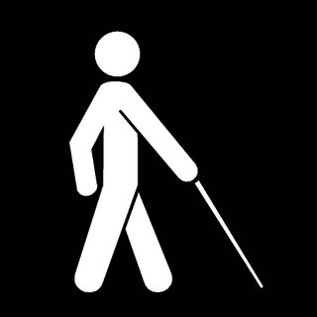
Simple reactive behaviors
Robots aren't useful if they can't adapt to what's happening in the real world.
There are ways around blindness, but there are limits to what's possible.
Notes:
2

Slide 3
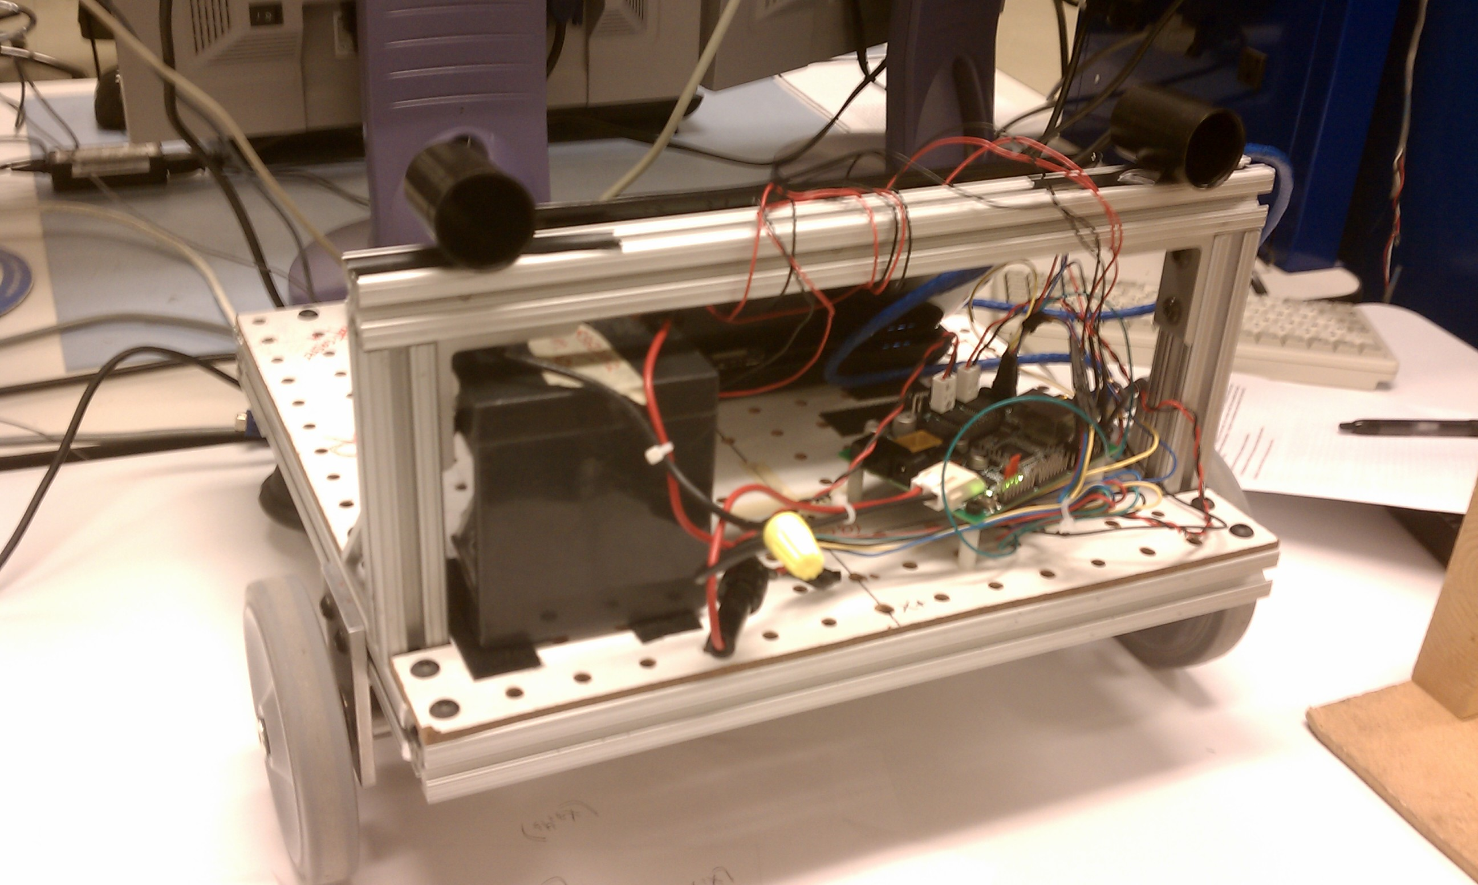
Light Sensors
Notes:
3

Slide 4
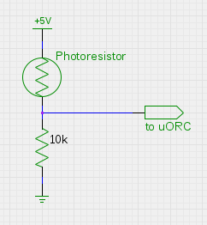
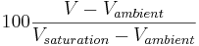
Photoresistor
Resistance:
Dark – 150k - 200k
Ambient – 10k - 30k
Saturation - 200
Calibration:
Notes:
4

Slide 5
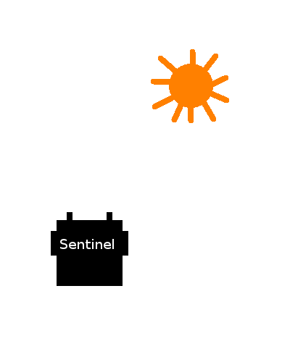
Searching for a light source
Low value
High value
Notes:
5

Slide 6
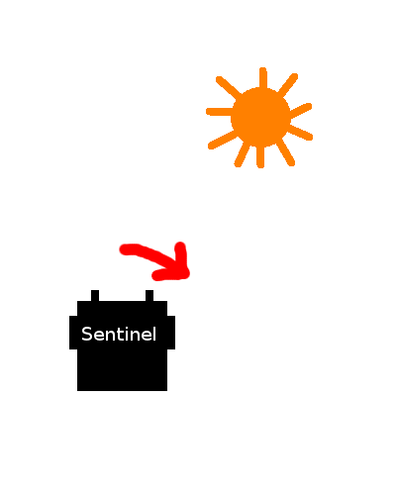
Searching for a light source
Low value
High value
Notes:
6

Slide 7
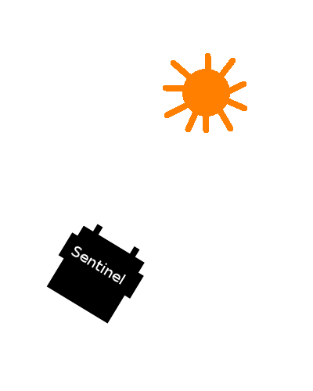
Searching for a light source
Roughly equal values
Notes:
7

Slide 8
Moving to a light source
Values below threshold
Notes:
8

Slide 9
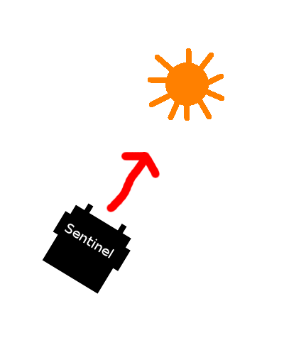
Moving to a light source
Values below threshold
Notes:
9

Slide 10
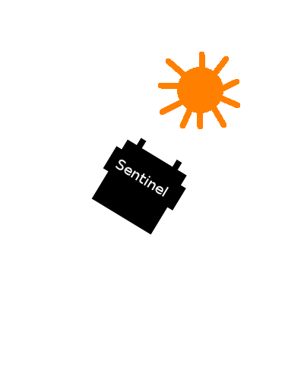
Moving to a light source
At least one value
above threshold
Notes:
10

Slide 11
Braitenberg Behaviors
Wheel velocities are simple functions of light sensor values
With very little work the robot can follow or avoid lights, or seem to have a variety of emotions
Puppy!
Shy...
Aggressive!
Excited, but afraid.
Notes:
11

Slide 12


Slide 13
What we learned
A wide range of emotions can be simulated with simple robot behavior in response to basic sensor input
Dan learned about photoresistors
Raga is good at video editing
Notes:
13

